Slide 1

Smart muffler
Team Member 1 Dhinesh.R
198
Team Member 2 Jinu.S
193
Team Member 3 Mohamed Nihal
203
Team Member 4 K.C.Vishal
200
Mentor
Vinoth Kumar G

Slide 2
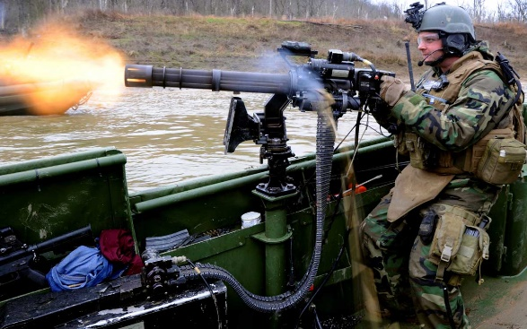
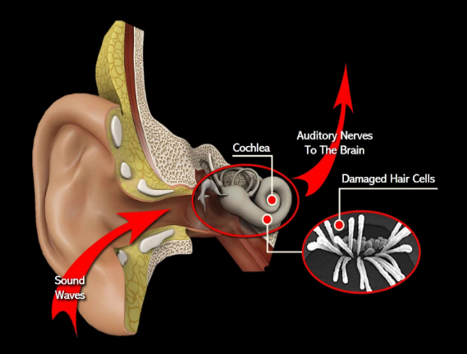
1. Background
Every day, we experience sound in our environment, such as the sounds from construction & industries, mining and traffic. Normally, these sounds are at safe levels that don’t damage our hearing. But sounds can be harmful when they are too loud, even for a brief time, or when they are both loud and long-lasting.
These sounds can damage sensitive structures in the inner ear and cause noise-induced hearing loss (NIHL) which can be temporary as well as permanent.
NIHL is categorised based on the sound pressure level (SPL) in the dB scale.

Slide 3
2. Sound Pressure Level Table
TYPES OF NOISE | DECIBLES
Normal Conversation | 60 – 70 dB
Movie Theatre | 74 – 104 dB
Motorcycles and dirt bikes | 80 – 110 dB
Music through headphones at maximum volume, sporting events, and concerts | 94 – 110 dB
City Traffic | 90– 129 dB
Ambulance Siren | 110 – 140 dB
Fireworks show | 140 – 160 dB

Slide 4
3. Idea Proposed
Using MATLAB we designed an algorithm which recognises background noise and calculate its pressure level in dB. Based on a threshold limit of dB level , the signal’s pressure level will be reduced to a safer limit for human ear
Designing the MATLAB algorithm for analyzing the signal in real time through a built in mic and generate the same signal with pressure levels within the limit
*
Designing a ear muffler (high NRR) with comfortable fit and variable size ear cups for versatility and retro fit the muffler with mic and built in speakers.
*
Uploading the algorithm to the hardware design and fine tuning the calibration values for best results.
*

Slide 5
4. Block Diagram – Smart Muffler
EXTERNAL MIC
PROCESSOR / CONTROLLER
DIGITAL FILTER
AUDIO SAMPLE
O/P SPEAKER
PROCESSED SIGNAL (<80dB)
SPL REDUCTION FOR >80 dB
O/P SIGNAL
<80 dB

Slide 6
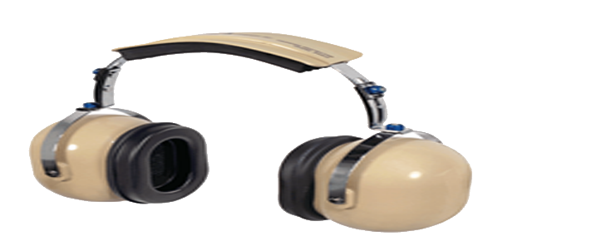
5. Conclusion & Future Work
As we were gathering the information from different sources, we had an idea to create a project for those who are working in industry, factory & military fields. Hence, we came with the conclusion of making the software part of the research idea during the current semester and expanding it to practical and real time simulations and scenarios.
In future we planned to create a working prototype model that is cost effective and has high accuracy useful in preventing NIHL across different domains.

Slide 7
5. References
Assessment of occupational noise-induced hearing loss for ACC: A practical guide for otolaryngologists
Targeting dysregulation of redox homeostasis in noise-induced hearing loss: Oxidative stress and ROS signalling
Risk Assessment of Recreational Noise–Induced Hearing Loss from Exposure through a Personal Audio System
Use of Hearing Protection to Discriminate Between Different and Identify Individual Noise Sources to Control and Reduce Risk of Noise Induced Hearing Loss
Screening of noise-induced hearing loss (NIHL)-associated SNPs and the assessment of its genetic susceptibility
Noise induced hearing loss (NIHL) in wasit corporation textile industries
Conventional audiometry, extended high-frequency audiometry, and DPOAE for early diagnosis of NIHL
Noise-Induced Hearing Loss (NIHL): literature review with a focus on occupational medicine
Reducing noise-induced hearing loss (NIHL) to achieve US Healthy People 2010 goals
Vital signs: noise-induced hearing loss among adults—United States 2011–2012
Occupational noise-induced hearing loss: ACOEM task force on occupational hearing loss
Combined effect of smoking and occupational exposure to noise on hearing loss in steel factory workers

Slide 8
Thank you

